Slide 1
Hackathon : Kick Start
A Aruna Kumari
Inceptz Institute
Datascience Batch:14

Slide 2
LASSO
What is Lasso Regression?
“LASSO” stands for Least Absolute Shrinkage and Selection Operator.

Slide 3
LASSO
Lasso regression is a type of linear regression that uses shrinkage.
Shrinkage is where data values are shrunk towards a central point, like the mean.
The lasso procedure encourages simple, sparse models (i.e. models with fewer parameters).
This particular type of regression is well-suited for models showing high levels of muticollinearity or when you want to automate certain parts of model selection, like variable selection/parameter elimination.

Slide 4
L1 Regularization
Lasso regression performs L1 regularization, which adds a penalty equal to the absolute value of the magnitude of coefficients. This type of regularization can result in sparse models with few coefficients; Some coefficients can become zero and eliminated from the model. Larger penalties result in coefficient values closer to zero, which is the ideal for producing simpler models.

Slide 5
L1 Regularization
On the other hand, L2 regularization (e.g. Ridge regression) doesn’t result in elimination of coefficients or sparse models. This makes the Lasso far easier to interpret than the Ridge.

Slide 6

Performing the Regression

Slide 7
RMSE
Root Mean Squared Error
RMSE is calculated as the square root of the mean of the squared differences between actual outcomes and predictions.
Squaring each error forces the values to be positive, and the square root of the mean squared error returns the error metric back to the original units for comparison.

Slide 8
Mean Absolute Error or MAE
We know that an error basically is the absolute difference between the actual or true values and the values that are predicted. Absolute difference means that if the result has a negative sign, it is ignored.
Hence, MAE = True values – Predicted values
MAE takes the average of this error from every sample in a dataset and gives the output.
This can be implemented using sklearn’s mean_absolute_error method:

Slide 9
Mean Absolute Error or MAE
But this value might not be the relevant aspect that can be considered while dealing with a real-life situation because the data we use to build the model as well as evaluate it is the same, which means the model has no exposure to real, never-seen-before data. So, it may perform extremely well on seen data but might fail miserably when it encounters real, unseen data

Slide 10
Underfitting And overfitting
The concepts of underfitting and overfitting can be pondered over, from here:
Underfitting: The scenario when a machine learning model almost exactly matches the training data but performs very poorly when it encounters new data or validation set.
Overfitting: The scenario when a machine learning model is unable to capture the important patterns and insights from the data, which results in the model performing poorly on training data itself.

Slide 11
Mean Squared Error or MSE
MSE is calculated by taking the average of the square of the difference between the original and predicted values of the data.

Slide 12
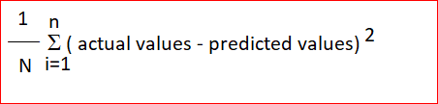
Mean Squared Error or MSE
Hence, MSE =

Slide 13
Root Mean Squared Error or RMSE
RMSE is the standard deviation of the errors which occur when a prediction is made on a dataset. This is the same as MSE (Mean Squared Error) but the root of the value is considered while determining the accuracy of the model.

Slide 14
R Squared
It is also known as the coefficient of determination. This metric gives an indication of how good a model fits a given dataset.
It indicates how close the regression line (i.e the predicted values plotted) is to the actual data values. The R squared value lies between 0 and 1 where 0 indicates that this model doesn't fit the given data and 1 indicates that the model fits perfectly to the dataset provided.

Slide 15
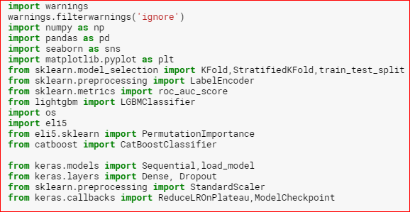
IMPORT LIBRARY

Slide 16
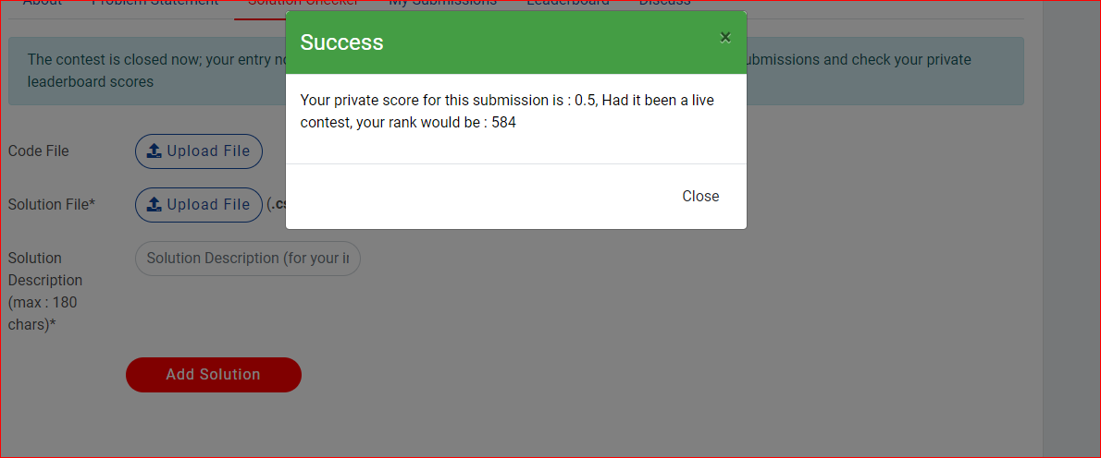
Janata hack cross sell

Slide 17
XGBOOST
Three main forms of gradient boosting are supported: Gradient Boosting algorithm also called gradient boosting machine including the learning rate. Stochastic Gradient Boosting with sub-sampling at the row, column and column per split levels. Regularized Gradient Boosting with both L1 and L2 regularization.

Slide 18
Why ensemble learning?
XGBoost is an ensemble learning method. Sometimes, it may not be sufficient to rely upon the results of just one machine learning model. Ensemble learning offers a systematic solution to combine the predictive power of multiple learners. The resultant is a single model which gives the aggregated output from several models.

Slide 19
Why ensemble learning?
The models that form the ensemble, also known as base learners, could be either from the same learning algorithm or different learning algorithms. Bagging and boosting are two widely used ensemble learners. Though these two techniques can be used with several statistical models, the most predominant usage has been with decision trees.

Slide 20
Bagging
While decision trees are one of the most easily interpretable models, they exhibit highly variable behavior. Consider a single training dataset that we randomly split into two parts. Now, let’s use each part to train a decision tree in order to obtain two models.

Slide 21
Bagging
When we fit both these models, they would yield different results. Decision trees are said to be associated with high variance due to this behavior. Bagging or boosting aggregation helps to reduce the variance in any learner. Several decision trees which are generated in parallel, form the base learners of bagging technique. Data sampled with replacement is fed to these learners for training. The final prediction is the averaged output from all the learners.

Slide 22
Boosting
In contrast to bagging techniques like Random Forest, in which trees are grown to their maximum extent, boosting makes use of trees with fewer splits. Such small trees, which are not very deep, are highly interpretable. Parameters like the number of trees or iterations, the rate at which the gradient boosting learns, and the depth of the tree, could be optimally selected through validation techniques like k-fold cross validation. Having a large number of trees might lead to overfitting. So, it is necessary to carefully choose the stopping criteria for boosting.

Slide 23
MY SOLUTION LINKS
https://www.kaggle.com/arunaakula/melanoma-tumor-size-prediction-weekend-hackathon/edit
https://www.kaggle.com/arunaakula/janata-hack-cross-sell/edit

